Slide 1


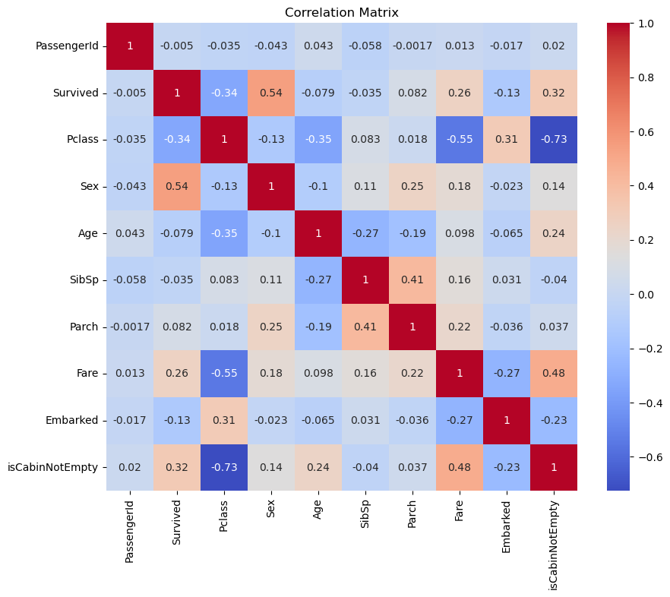
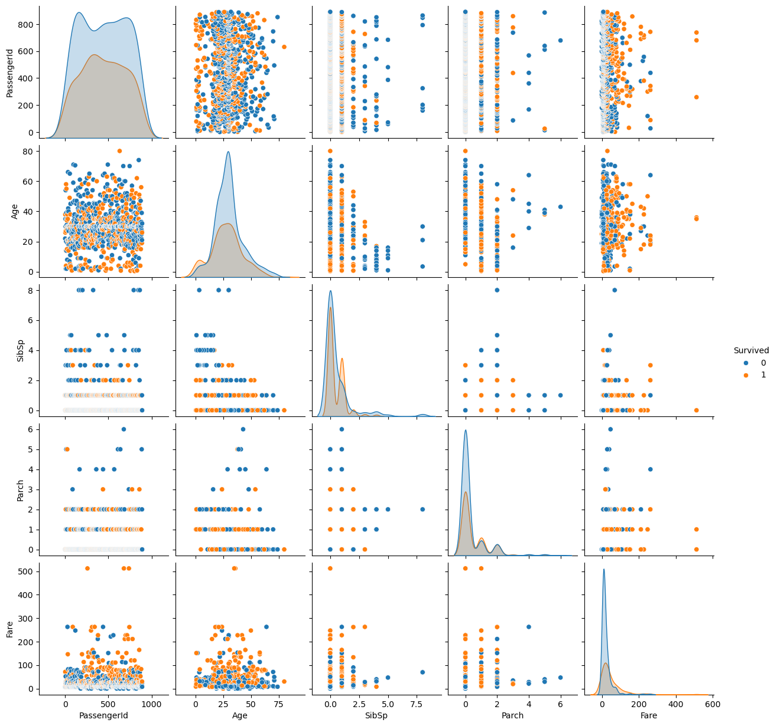
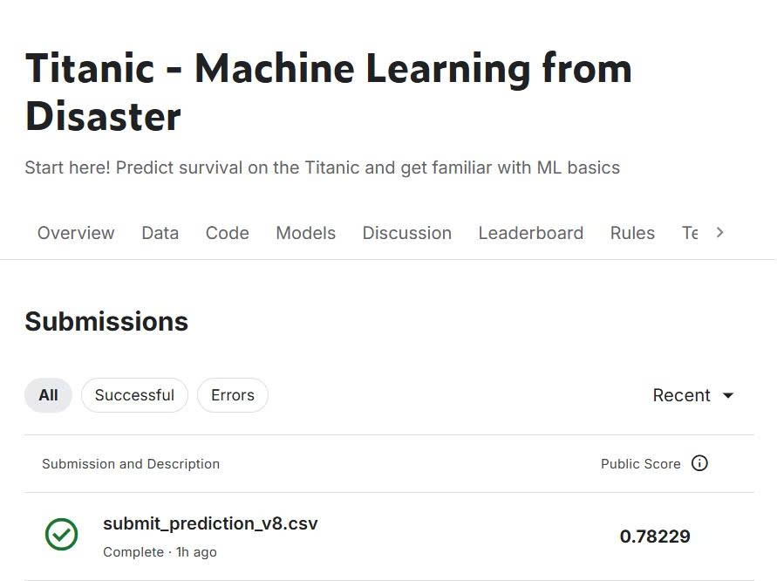
Titanic – Machine Learning from Disaster
Duong Tung Thien Ho Minh Tien Nguyen Toan Thang Dang Thai Tu
INTRODUCTION
METHODOLOGY
EXPLAIN YOUR GRAPHS
Problems Definition: The Titanic disaster resulted in a high number of casualties, with only a portion of passengers surviving. The task is to determine which factors most strongly influenced survival.
Challenge: The dataset includes missing values and mixed categorical/numerical variables, making it difficult to model survival probability accurately.
Thesis Goal: Apply machine learning methods to analyze the Titanic dataset and build a predictive model capable of achieving around 80% accuracy in identifying which passengers surived.
The approach involves several stages: importing and preprocessing data, handling missing values, exploring correlations, encoding categorical variables, normalizing numerical data, and testing multiple machine learning algorithms (e.g., Logistic Regression, Decision Tree, Random Forest). Model performance is evaluated using accuracy as the main metric.
CONCLUSIONS PRINCIPALES
The analysis demonstrates that social and demographic factors—especially sex and passenger class—play crucial roles in survival. Machine learning models like Random Forest and Logistic Regression perform best in predicting outcomes, achieving accuracy close to the targeted 0.8 Kaggle score.
Correlation heatmap
Pairplot (Numeric variables)
ANALYSE
Exploratory data analysis shows that gender, class, and age are key factors influencing survival. Women and children, as well as first-class passengers, had higher survival rates. Correlation analysis and feature visualization confirm these relationships, guiding model feature selection and refinement
OBJECTIVE
The main objective of the project is to explore the Titanic dataset, perform data cleaning and analysis, and develop a reliable prediction model that can forecast passenger survival based on given attributes such as age, sex, and passenger class.
CONCLUSION
The study successfully identifies the most significant survival predictors and shows that machine learning can effectively model such historical data. The resulting model not only predicts survival with reasonable accuracy but also provides insights into how social hierarchy and gender affected survival during the Titanic tragedy.

